Slide 1
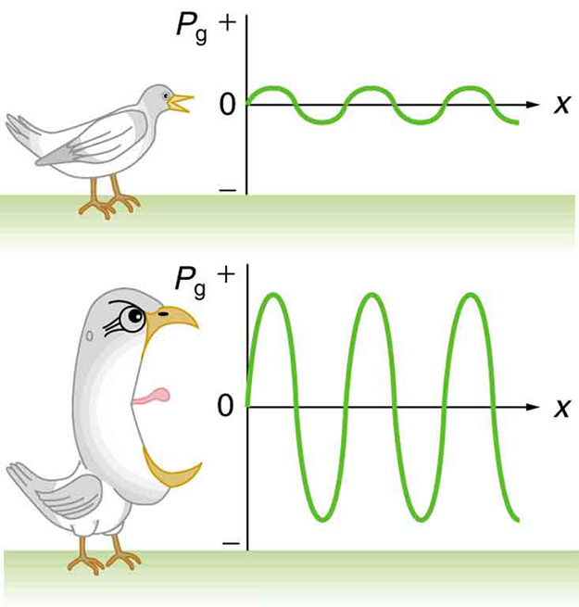
Properties of Sound Waves

Slide 2
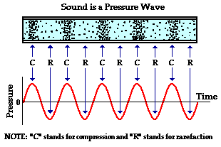
What is a Sound Wave?
Sound is a longitudinal wave with areas of high and low pressure
Notes:
The higher the amplitude is, the louder the sound
Frequency is the number of waves measured per second (in Hertz Hz) – the higher the frequency, the higher the pitch

Slide 3

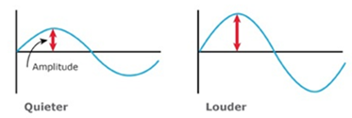
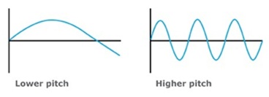
What is a Sound Wave?
Here, the amplitude relates to pressure (more pressure = more energy, volume, and intensity)
The frequency relates to the pitch
Notes:
The higher the amplitude is, the louder the sound
Frequency is the number of waves measured per second (in Hertz Hz) – the higher the frequency, the higher the pitch
To get a better sense of what these terms mean to a sound wave, try the pHet sound simulation “listen to a single source” and play with the sliders to the right.
https://phet.colorado.edu/en/simulation/legacy/sound

Slide 4
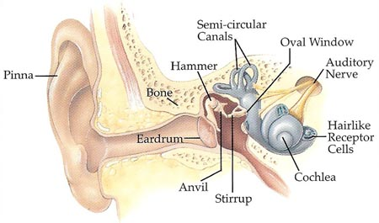
Categories of Sound Waves
1. Audible Sound Waves: within the range of human hearing (20 Hz to 20 kHz)
Notes:
How does the ear hear sound?
Process of Hearing
http://www.youtube.com/watch?v=pCCcFDoyBxM
An Overview of the Mechanism of Hearing
http://www.youtube.com/watch?v=GpkD8AZTFCs

Slide 5
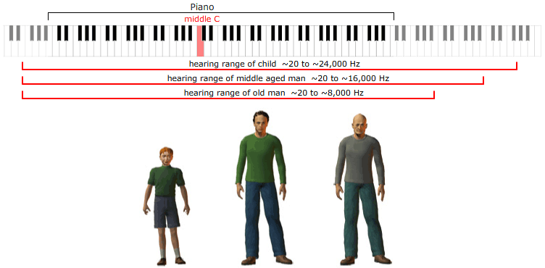
How Human Hearing Changes
As we age we lose the ability to hear higher frequency notes

Slide 6
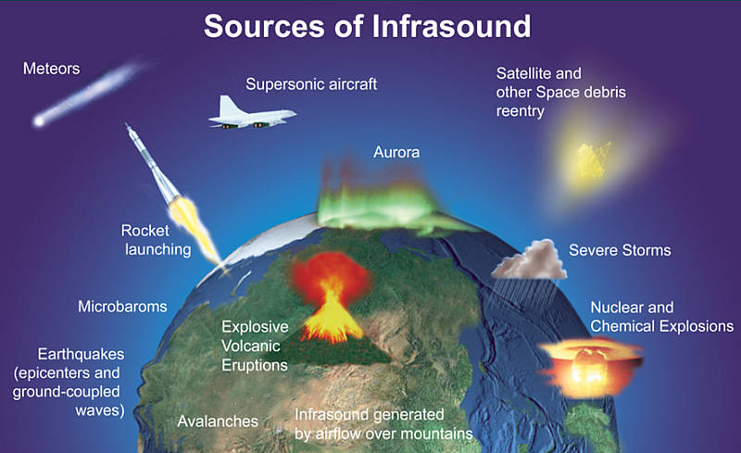
Categories of Sound Waves
2. Infrasonic Waves: extend below the range of human hearing (below 20 Hz)
Notes:
Microbarom: from surface waves on sea or ocean
Specific range from: http://meteor.uwo.ca/research/infrasound/is_whatisIS.html

Slide 7

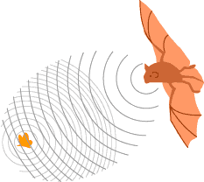

Categories of Sound Waves
3. Ultrasonic Waves: extend above the range of human hearing (above 20 kHz)
Diagnosis
Treatment
Echolocation
Notes:
Ultrasonic waves are safer than X-rays, however the images may not be as detailed
Diagnosis: observation of fetus’ in pregnant women
Treatment: break up kidney stones that are too large to pass
Echolocation: used by animals to determine distances. Humans have also utilized this method in some cameras used for surveying etc.

Slide 8
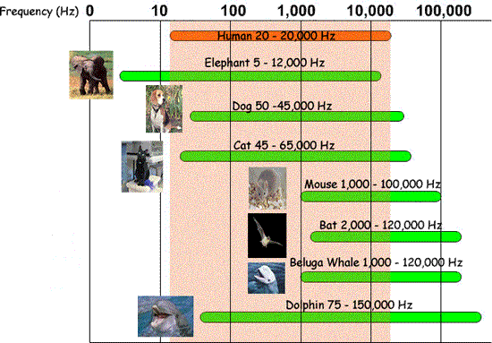
Do All Animals Hear Equally?

Slide 9
How Fast Are Sound Waves?
The speed of a sound wave depends on the temperature of the air:
Where v is the speed of sound (m/s)
T is the temperature of the air (ºC)
Notes:
The constants in this equation vary slightly from textbook to textbook

Slide 10

Example
a) If the temperature in the classroom is 20ºC, what is the speed of sound in the classroom?
b) How long will the sound of Ms. Jurisevic’s voice take to reach a student who is sitting:
i) 2.5 m away?
ii) 6.0 m away?

Slide 11
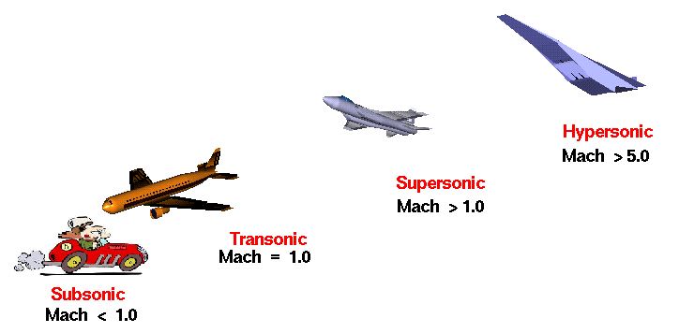
The Mach Number
For very fast objects, you may have heard their speed described by a “Mach Number”.
This is their speed compared to the speed of sound.

Slide 12
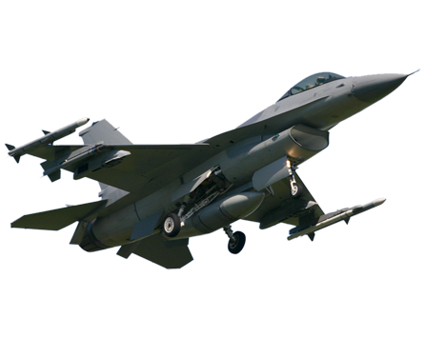
Example
A jet is flying at 905 km/h at an altitude where the temperature is -30ºC. Determine the mach number of the jet.

Slide 13
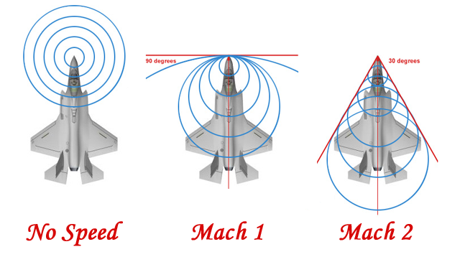

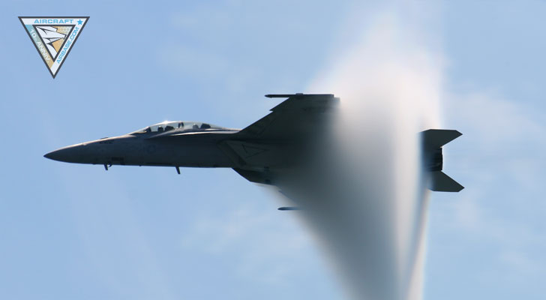
Exceeding the Speed of Sound
Objects travelling faster than the speed of sound create a loud noise referred to as a sonic boom.
Notes:
The Sonic Boom Problem – Ted Ed https://www.youtube.com/watch?v=JO4_VHM69oI
As you travel at subsonic speeds, you emit sound waves in all directions
As you approach the speed of sound, these waves are no longer to move outwards in front of you (the air molecules start to ‘pile up’ in front of the vehicle)
Once you hit/exceed the speed of sound, you essentially break through these molecules, they release a ‘cone’ of compression (aka a shock wave) – this is the sonic boom that we hear. As long as the plane is flying at or beyond the speed of sound, this shock wave continues (this is the ‘sonic boom we hear as a jet flies past us’)

